Slide 1
THE REPOSITIONED SCHOOL LEADER
MRS JULIET EHIWARIOR OLADITI

Slide 2
OBJECTIVES
MINDSET
Change What No Longer Serves the School having seen
Hidden cost of poor leadership practices.

Slide 3


MY YOUNGER SELF

Slide 4
MASTERY
Know What You Lead .
Develop practical mastery of 2 key areas school leaders are responsible for.

Slide 5
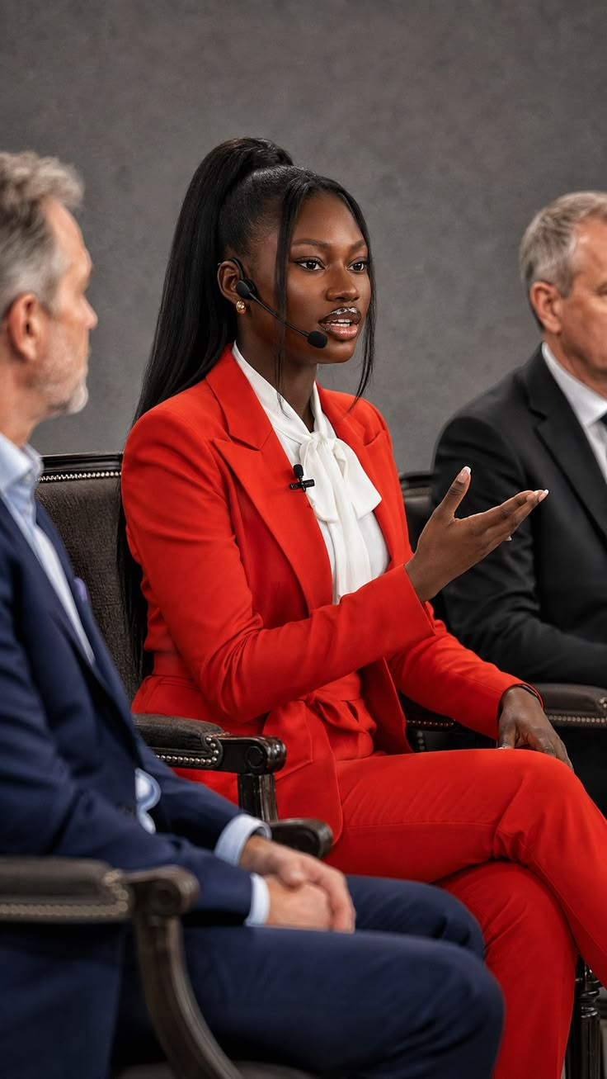
REPRESENTATIVE
That one staff that you can ask to represent you anywhere

Slide 6
Your vision is only as good as YOUR drivers (Staff)
THEY DON’T NEED YOUR PERMISSION TO REPRESENT YOU.
ANYWHERE AN Y TIME, THEY CARRY YOUR AUTHORI TY VALUES BRAND AND YOUR REPUTATION.

Slide 7
MINDSET SHIFT 1
TRAIN YOUR STAFF TO REPRESENT YOUR ORGANIZATION NOT PROTECT YOUR ORGANIZATION FROM UNTRAINED STAFF

Slide 8
WHAT IF THEY LEAVE AFTER TRAINING THEM?
Build a culture of knowledge transfer( make the trained person responsible for transferring what they have learnt to others)
Put the knowledge into a school system ( personal to institutional)

Slide 9
MY SCHOOL IS YOUNG AND NO MONEY
Train in little doses.
✓Staff briefing eg How To Correct a Child without Humiliation, How To Respond to an Angry Parent
✓WhatsApp group ( Short valuable article/ video/ resources
NB; Don’t share randomly. Make learning problem based.
✓ Make Continuous Professional Development s culture ( C PD hours, Allison)

Slide 10
MINDSET SHIFT 2
NORMALIZE RECEIVING FEEDBACK
✓WHISTLE BLOWING
✓HONEST FEEDBACK

Slide 11
WHAT IS WHISTLE BLOWING?
This when someone raises a concern about wrongdoing, misconduct, danger or unethical behavior that could harm people or the organization
CASE STUDY: Esther 2:22-23

Slide 12
HANDLING WHISTLE BLOWING
Investigate
Protect Confidentiality ( Don’t make the person a target of victimization)

Slide 13
HONEST FEEDBACK ( unflattering)
Feedback is not insubordination.
Any organization that can’t hear hard truth will hear expensive consequences
Leadership usually sees consequences. Staff often see causes.
They see the small cracks (the parents complaint, short cuts being taken… )
Consequence: pry 4 teacher resigned, Mrs Eze withdrew her children…
Staff often know why
Let them speak honestly and politely. ( The danger of not letting them is enormous)

Slide 14
MINDSET SHIFT 3
Don’t Waste Problem. Learn from it
Deal with the problem. Stop the damage. Met out penalties as per policy.
Then sit and reflect.
What leak or slip in our operations made this happen?
My Week 4 ( no teaching lesson)

Slide 15
SOLUTION
What in our system needs to change
How do we make sure this never happens again.
MASTERY 👉🏾

